Slide 1
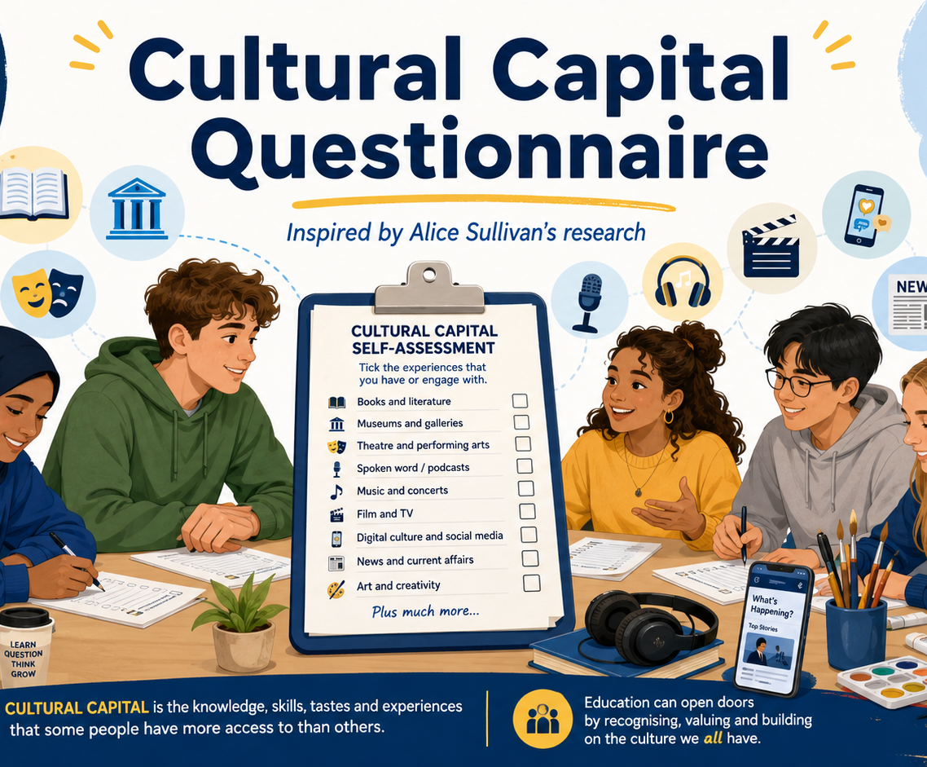
Cultural Capital
Questionnaire
Inspired by Alice Sullivan’s research into cultural capital and educational achievement
Teacher display deck | AQA A Level Sociology: Education
Use this activity to explore how schools may reward particular forms of knowledge, language and cultural confidence.
The Sociology Guy
Notes:
Use this deck alongside the printed questionnaire or the online interactive version. Emphasise that the aim is sociological reflection, not ranking students.

Slide 2
What is cultural capital?
Cultural capital is not the same as intelligence or personal worth.
This questionnaire asks about reading habits, cultural activities, media knowledge and familiarity with cultural figures.
In sociology, cultural capital means the knowledge, language, tastes and cultural experiences that may be valued by schools, universities and employers.
Key reminder for students
Sociological focus
Everyone has culture.
The question is which forms of culture are most rewarded in education.
Answer honestly — there are no “good” or “bad” scores.
How schools recognise certain knowledge and language.
How class advantages may be reproduced.
How popular and digital culture can also be valuable.
Cultural Capital Questionnaire | Alice Sullivan | AQA Sociology
The Sociology Guy
Notes:
Display before distributing the questionnaire. Reassure students that this is not a “culture test” and should not be used to label individuals.

Slide 3
Alice Sullivan’s research: the core idea
Cultural capital and educational attainment
1
What Sullivan explored
2
How she measured it
Whether access to certain forms of cultural knowledge, reading habits, vocabulary and cultural participation was linked to higher educational achievement.
Pupils were asked about reading, cultural activities, television habits, vocabulary and knowledge of cultural figures.
3
What she found
4
Why it matters
Cultural capital had a significant effect on GCSE results, but did not fully explain class differences in achievement.
The study supports Bourdieu, while also giving students evaluation: cultural capital matters, but it is not the whole explanation.
Exam link: useful for AQA Education essays on social class, external factors, cultural deprivation/capital and social reproduction.
Cultural Capital Questionnaire | Alice Sullivan | AQA Sociology
The Sociology Guy
Notes:
This slide summarises Sullivan’s research in accessible form. Connect it to Bourdieu’s idea that schools reward dominant cultural codes.

Slide 4
How to administer the questionnaire
A 15–20 minute individual activity followed by class discussion
1
Set the tone
2
Complete individually
3
Score sensitively
Explain that the questionnaire can be anonymous and that the purpose is sociological reflection, not judgement.
Give students around 15–20 minutes. They should answer honestly rather than trying to guess the “right” answer.
Students calculate their own score. Teachers may collect anonymous class totals, but avoid ranking students.
Before they begin, explain:
There are no “good” or “bad” scores.
A lower score does not mean someone lacks culture.
The activity is about which forms of culture schools may recognise.
Use the scores to link to Bourdieu, Sullivan and educational inequality.
Cultural Capital Questionnaire | Alice Sullivan | AQA Sociology
The Sociology Guy
Notes:
This is a teacher instruction slide. You may decide whether students write names on sheets. Anonymous is usually safer.

Slide 5
Part 1: response scale
For each statement, students circle one score
0
Never or hardly ever
1
Sometimes
2
Often
3
Very often / part of my normal routine
This experience is not part of my usual cultural routine.
This is something I do now and again.
This is something I do regularly.
This is a normal part of my cultural life.
Maximum score for Part 1: 60 marks. Each section has 5 questions and a maximum of 15 marks.
Cultural Capital Questionnaire | Alice Sullivan | AQA Sociology
The Sociology Guy
Notes:
Give students the scoring system before they complete the questionnaire. Stress that the score is a starting point for sociological discussion.

Slide 6
Section A: Reading and language
SECTION A
Language, vocabulary and confidence with texts
Circle one answer for each statement: 0 = never | 1 = sometimes | 2 = often | 3 = very often
1. I read fiction, non-fiction, biography, journalism or long-form articles outside lessons.
0 / 1 / 2 / 3
2. I read books or articles that make me think about society, identity, politics, history or inequality.
0 / 1 / 2 / 3
3. I feel confident understanding unfamiliar words or academic vocabulary.
0 / 1 / 2 / 3
4. I discuss books, films, news stories, ideas or social issues with friends, family or teachers.
0 / 1 / 2 / 3
5. I use libraries, bookshops, e-books, audiobooks or online reading platforms to find new things to read.
0 / 1 / 2 / 3
A total: ______ / 15
Cultural Capital Questionnaire | Alice Sullivan | AQA Sociology
The Sociology Guy

Slide 7
Section B: Cultural participation
SECTION B
Access to cultural spaces and activities
Circle one answer for each statement: 0 = never | 1 = sometimes | 2 = often | 3 = very often
1. I visit museums, galleries, exhibitions, heritage sites or public lectures.
0 / 1 / 2 / 3
2. I attend theatre, spoken-word events, live music, festivals, cinema screenings or community arts events.
0 / 1 / 2 / 3
3. I take part in creative activities such as music, drama, dance, art, creative writing, photography or content creation.
0 / 1 / 2 / 3
4. I feel confident entering cultural spaces such as galleries, universities, libraries, theatres or museums.
0 / 1 / 2 / 3
5. I have been encouraged by someone at home or school to try new cultural activities.
0 / 1 / 2 / 3
B total: ______ / 15
Cultural Capital Questionnaire | Alice Sullivan | AQA Sociology
The Sociology Guy

Slide 8
Section C: News, ideas and public culture
SECTION C
Wider examples, public debate and social issues
Circle one answer for each statement: 0 = never | 1 = sometimes | 2 = often | 3 = very often
1. I follow news, current affairs or social issues through reliable sources.
0 / 1 / 2 / 3
2. I watch documentaries, interviews, explainers or educational videos about society and culture.
0 / 1 / 2 / 3
3. I listen to podcasts, radio, debates or long-form discussions about ideas, history, politics or culture.
0 / 1 / 2 / 3
4. I can connect examples from the media, politics or everyday life to sociological ideas.
0 / 1 / 2 / 3
5. I feel able to explain my opinions using evidence or examples.
0 / 1 / 2 / 3
C total: ______ / 15
Cultural Capital Questionnaire | Alice Sullivan | AQA Sociology
The Sociology Guy

Slide 9
Section D: Digital and popular culture
SECTION D
Recognising digital, youth and popular culture as valuable
Circle one answer for each statement: 0 = never | 1 = sometimes | 2 = often | 3 = very often
1. I understand references from music, streaming, gaming, online creators or social media culture.
0 / 1 / 2 / 3
2. I notice how identity, class, gender, ethnicity or age are represented in popular culture.
0 / 1 / 2 / 3
3. I can explain why some cultural products become popular or controversial.
0 / 1 / 2 / 3
4. I create, edit, remix, review or share cultural content online.
0 / 1 / 2 / 3
5. I can compare popular culture with more traditional forms of culture.
0 / 1 / 2 / 3
D total: ______ / 15
Cultural Capital Questionnaire | Alice Sullivan | AQA Sociology
The Sociology Guy

Slide 10
Part 2: Cultural Knowledge Quiz
This updates Sullivan’s cultural knowledge approach with contemporary examples
Students circle one answer for each question.
Each correct answer = 2 marks. Incorrect or unanswered = 0 marks.
Maximum quiz score = 24 marks. Overall maximum = 84 marks.
Teacher framing
This is not a “who knows the most?” test.
Some examples are traditional school-recognised culture.
Others come from popular, digital, activist and global culture.
The point is to ask which forms of knowledge schools reward.
Cultural Capital Questionnaire | Alice Sullivan | AQA Sociology
The Sociology Guy
Notes:
You can display the quiz slides one at a time or allow students to complete from the printed worksheet.

Slide 11
Cultural Knowledge Quiz: Questions 1–2
Each correct answer = 2 marks | Circle one answer
1. George Orwell is most closely associated with:
2. Malorie Blackman is best known for:
A. Dystopian and political fiction such as 1984 and Animal Farm
A. Designing the London Underground map
B. The invention of grime music
B. Noughts & Crosses and writing about race, power and inequality
C. Abstract expressionist painting
C. Creating the theory of cultural capital
D. Climate protest in Sweden
D. Writing Macbeth
Answer: ____
Answer: ____
Cultural Capital Questionnaire | Alice Sullivan | AQA Sociology
The Sociology Guy

Slide 12
Cultural Knowledge Quiz: Questions 3–4
Each correct answer = 2 marks | Circle one answer
3. Bernardine Evaristo is associated with:
4. William Shakespeare is most closely linked to:
A. The discovery of DNA
A. Street art and graffiti
B. The creation of TikTok
B. Modern climate activism
C. Contemporary British literature, including Girl, Woman, Other
C. Plays, poetry and the English literary canon
D. Classical ballet in the nineteenth century
D. The Marvel Cinematic Universe
Answer: ____
Answer: ____
Cultural Capital Questionnaire | Alice Sullivan | AQA Sociology
The Sociology Guy

Slide 13
Cultural Knowledge Quiz: Questions 5–6
Each correct answer = 2 marks | Circle one answer
5. Chimamanda Ngozi Adichie is known for:
6. Banksy is most closely associated with:
A. Creating Minecraft
A. Victorian poetry
B. Novels and essays on identity, feminism and postcolonial experience
B. Street art, satire and political visual culture
C. Painting the Mona Lisa
C. Classical opera
D. Leading the 1944 Education Act
D. Functionalist sociology
Answer: ____
Answer: ____
Cultural Capital Questionnaire | Alice Sullivan | AQA Sociology
The Sociology Guy

Slide 14
Cultural Knowledge Quiz: Questions 7–8
Each correct answer = 2 marks | Circle one answer
7. Stormzy is associated with:
8. Taylor Swift is most closely linked to:
A. Ancient Greek philosophy
A. Global pop music, songwriting and fan culture
B. The Brontë sisters
B. The sociology of education
C. Grime, British popular culture and social commentary
C. Cubist painting
D. Renaissance sculpture
D. The invention of the printing press
Answer: ____
Answer: ____
Cultural Capital Questionnaire | Alice Sullivan | AQA Sociology
The Sociology Guy

Slide 15
Cultural Knowledge Quiz: Questions 9–10
Each correct answer = 2 marks | Circle one answer
9. Michaela Coel is associated with:
10. Yayoi Kusama is best known for:
A. The theory of evolution
A. Writing Noughts & Crosses
B. Television writing, acting and stories about identity, consent and power
B. Creating drill music
C. Romantic poetry
C. Contemporary visual art, installations and repeated dot patterns
D. The functionalist theory of socialisation
D. Developing Marxist sociology
Answer: ____
Answer: ____
Cultural Capital Questionnaire | Alice Sullivan | AQA Sociology
The Sociology Guy

Slide 16
Cultural Knowledge Quiz: Questions 11–12
Each correct answer = 2 marks | Circle one answer
11. Malala Yousafzai is associated with:
12. Greta Thunberg is associated with:
A. Campaigning for girls’ education
A. The jazz age
B. Writing Hamlet
B. The New Right view of education
C. Inventing Instagram
C. Writing The Lord of the Rings
D. Creating the hidden curriculum
D. Climate activism and youth protest
Answer: ____
Answer: ____
Cultural Capital Questionnaire | Alice Sullivan | AQA Sociology
The Sociology Guy

Slide 17
Scoring instructions
Students add section totals, quiz score and percentage
Add up:
Calculate percentage
Section A Reading and language: _____ / 15
Section B Cultural participation: _____ / 15
Section C News and public culture: _____ / 15
Section D Digital and popular culture: _____ / 15
Questionnaire total: _____ / 60
Cultural knowledge quiz: _____ / 24
Overall total: _____ / 84
Your score ÷ 84 × 100 = _____ %
Answer key
1 A 2 B 3 C 4 C
5 B 6 B 7 C 8 A
9 B 10 C 11 A 12 D
Cultural Capital Questionnaire | Alice Sullivan | AQA Sociology
The Sociology Guy
Notes:
You may reveal the answer key after students have completed the quiz.

Slide 18
Teacher coding instructions
Use this if collecting anonymous class totals
Part 1: questionnaire coding
Part 2: quiz coding
Never or hardly ever = 0
Sometimes = 1
Often = 2
Very often / part of my normal routine = 3
Maximum score for each section = 15
Maximum questionnaire score = 60
Each correct answer = 2
Each incorrect answer = 0
Each unanswered question = 0
Maximum quiz score = 24
Total possible score = 84
Cultural Capital Questionnaire | Alice Sullivan | AQA Sociology
The Sociology Guy
Notes:
If collecting totals, collect percentage bands rather than individual scores to reduce embarrassment.

Slide 19
Score interpretation
Use as a discussion starter — not as a judgement of students
0–29%
Specialised cultural capital profile
60–79%
Broad school-recognised cultural capital
More specialised, personal, local, digital or popular knowledge rather than culture traditionally rewarded by schools.
Familiarity with several forms of culture useful in education, such as reading, public debate and wider examples.
30–59%
Mixed cultural capital profile
80–100%
Very broad school-recognised repertoire
Some familiarity with school-recognised cultural capital, alongside other forms of culture.
Wide range of cultural knowledge and experience that may be recognised by schools, universities or employers.
Cultural Capital Questionnaire | Alice Sullivan | AQA Sociology
The Sociology Guy
Notes:
Emphasise that all bands are profiles, not grades. A low score does not mean less culture.

Slide 20
Teacher explanation after scoring
Connect individual reflection to sociological explanation
1
Cultural capital ≠ intelligence
2
Bourdieu
3
Sullivan
It refers to the types of knowledge, language, tastes and experiences valued in particular social settings.
Middle-class students may gain an advantage because schools treat their culture as normal, natural or superior.
Cultural capital affected GCSE results, but did not fully explain class differences in achievement.
Evaluation points to draw out
Cultural capital matters, but it is not the only factor.
Material factors, school processes and labelling may also matter.
Gender, ethnicity, parental income and wider inequalities can shape achievement.
Popular and digital culture can also carry skill, knowledge and identity.
Cultural Capital Questionnaire | Alice Sullivan | AQA Sociology
The Sociology Guy
Notes:
Use this as your post-activity explanation. Encourage students to connect the activity to exam concepts.

Slide 21
Discussion questions
Move from personal scores to sociological analysis
School and exams
Culture and power
Which questions seemed most linked to school success?
Are schools more likely to reward reading and academic vocabulary than digital or popular culture?
How might cultural capital help students in exams?
How might it help in interviews, university applications or employment?
What other factors might explain achievement?
Which questions involved valuable knowledge that schools may ignore?
Does this questionnaire risk treating middle-class culture as superior?
How could popular culture, online culture or youth culture also be cultural capital?
Why does Sullivan’s research support Bourdieu?
Why does Sullivan’s research also limit Bourdieu’s argument?
Cultural Capital Questionnaire | Alice Sullivan | AQA Sociology
The Sociology Guy
Notes:
These can be used in pairs, groups or whole-class discussion.

Slide 22
Optional written task
AQA-style paragraph practice
Write one paragraph answering: “Using the idea of cultural capital, explain one way in which social class may affect educational achievement.”
Sentence starters
One way social class may affect educational achievement is through cultural capital. Cultural capital means…
Bourdieu argued that…
Alice Sullivan’s research supports this because…
This may give some students an advantage because…
However, cultural capital may not fully explain achievement because…
Cultural Capital Questionnaire | Alice Sullivan | AQA Sociology
The Sociology Guy
Notes:
Set this as a 7-minute written task. Then ask students to underline AO1 knowledge and AO2 application.

Slide 23
Final sociology takeaway
Schools do not just assess knowledge. They may also reward particular ways of speaking, reading, writing, behaving and recognising culture.
The sociological question is not “Who has culture?”
It is: “Whose culture gets recognised as valuable?”
Connect to: Bourdieu | Sullivan | Social class | Educational achievement | Evaluation
Notes:
Use this as the exit point or plenary question.

