Slide 1
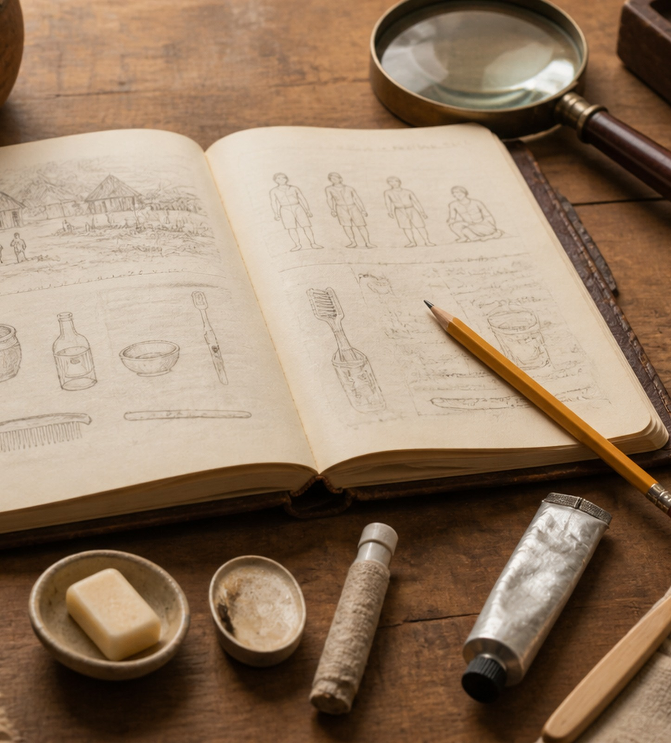
TEACHER RESOURCE
Miner’s
Nacirema
Making the familiar strange
A copy-ready teaching deck for introducing culture, norms, values, socialisation and cultural relativism to OCR and AQA A-level Sociology students.
45–60 minutes
Beginner
AO1 + AO2
Notes:
Use this as a complete lesson or as the opening 30 minutes of a culture/socialisation lesson. The aim is to get students to see everyday behaviour as socially produced rather than natural.

Slide 2
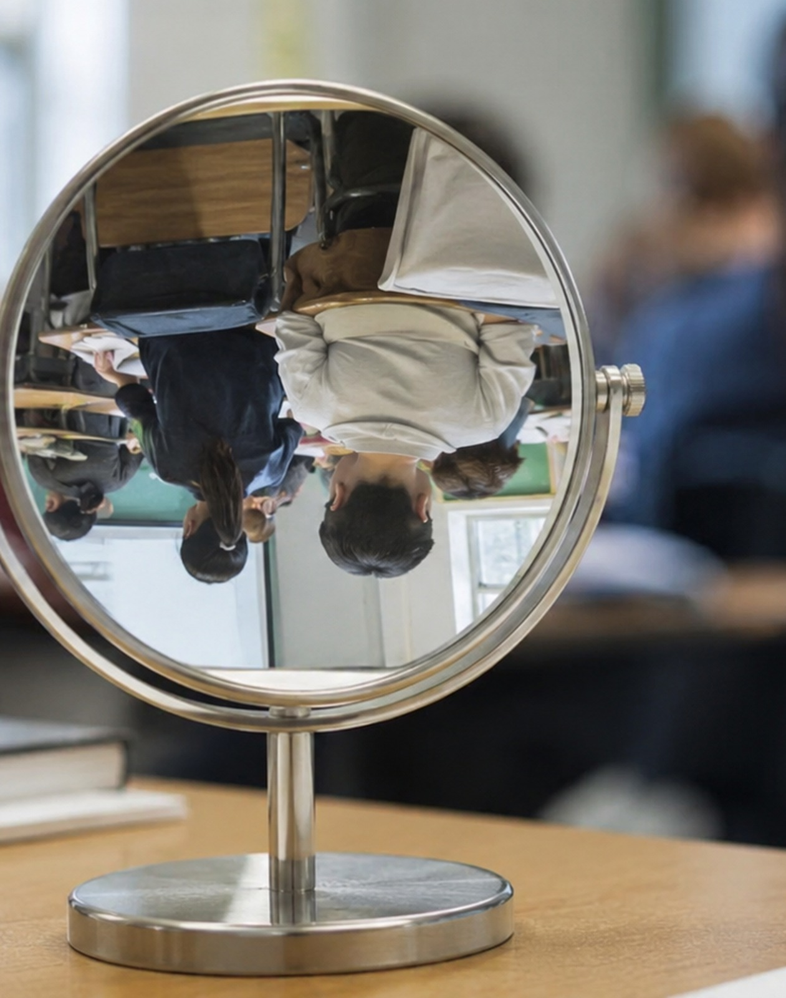
Why use Miner with new students?
It turns “common sense” into something students can question.
Miner helps students experience a core sociological habit:
Make the familiar strange
The study is often used because students quickly realise that “normal” routines — brushing teeth, visiting doctors, sitting in classrooms, checking phones — can look very unusual when described from an outsider perspective.
OCR link
Culture, socialisation, identity; the relative nature of norms and values.
AQA link
Culture and Identity; Education; socialisation, identity and social construction.
Skill link
AO2: apply concepts to everyday UK examples.
The Sociology Guy | OCR + AQA A-level Sociology
02
Notes:
Keep this student friendly. The purpose is not to memorise lots of detail from Miner, but to use the study as a route into sociological thinking.

Slide 3
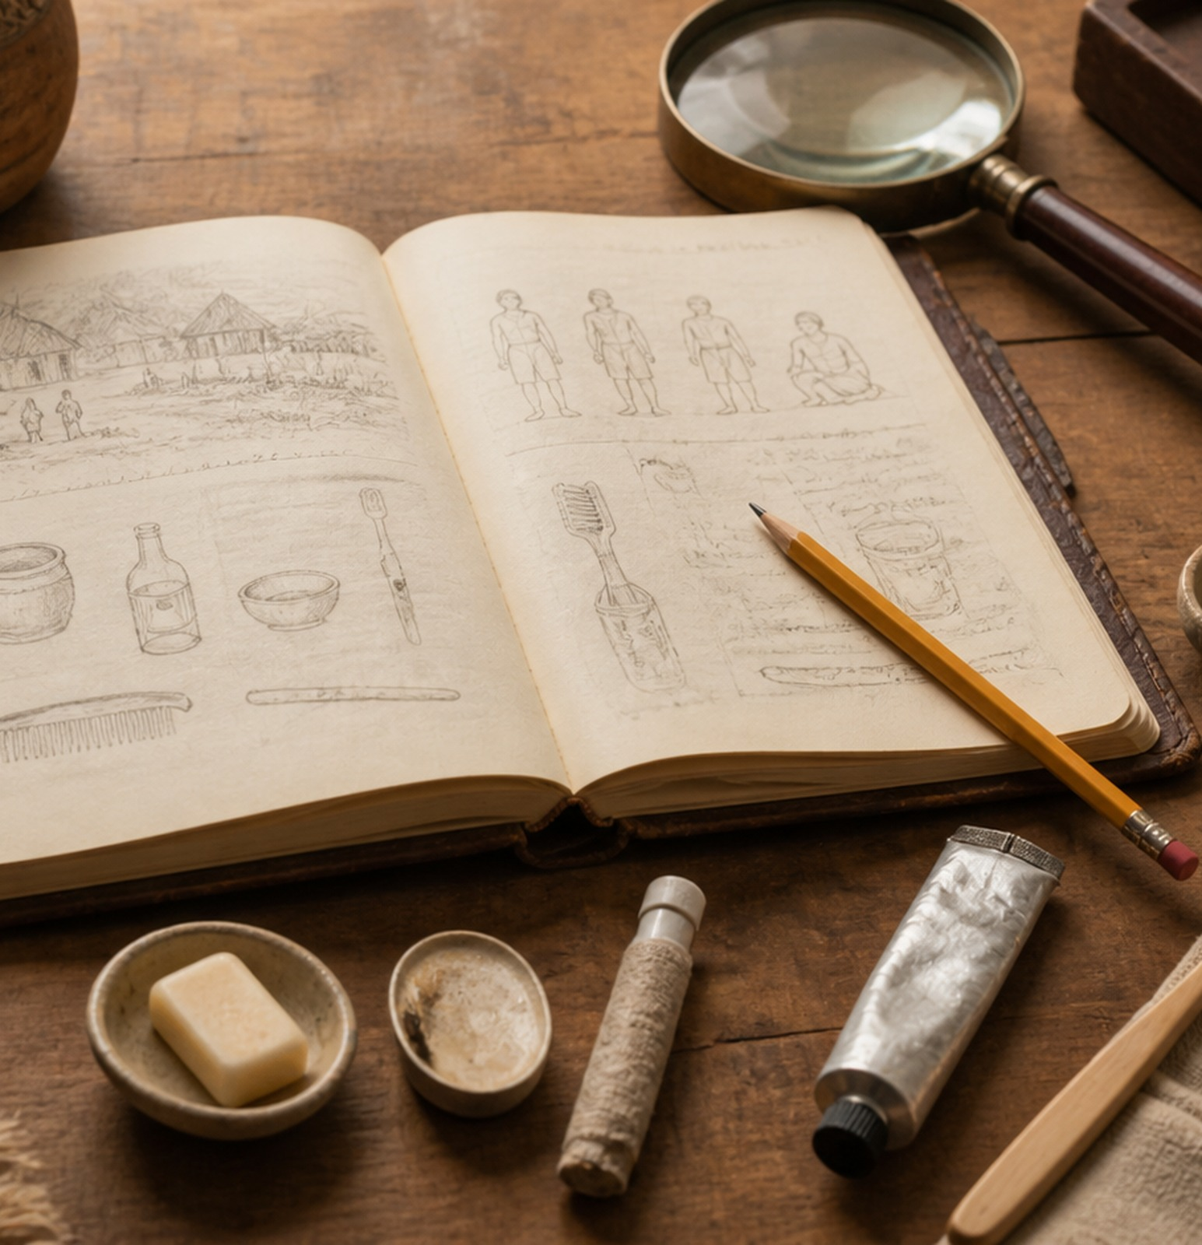
Miner’s study: the quick overview
Horace Miner, “Body Ritual among the Nacirema”, American Anthropologist, 1956.
The “twist”
• Miner appears to describe an unfamiliar North American “tribe”.
• The rituals sound strange, magical and extreme.
• “Nacirema” is “American” spelt backwards.
• The “rituals” are everyday American body, health and hygiene practices.
Teaching point
The study shows that culture is not simply “what other people do”. Our own routines can also be analysed as cultural practices with hidden meanings, values and social rules.
Reference: Miner, H. (1956) Body Ritual among the Nacirema, American Anthropologist, 58(3), 503–507.
The Sociology Guy | OCR + AQA A-level Sociology
03
Notes:
Explain the anagram only after students have read or heard a short extract. That delayed reveal is what makes the study memorable. Avoid presenting this as a conventional research method study; it is better used as a satirical teaching device.

Slide 4
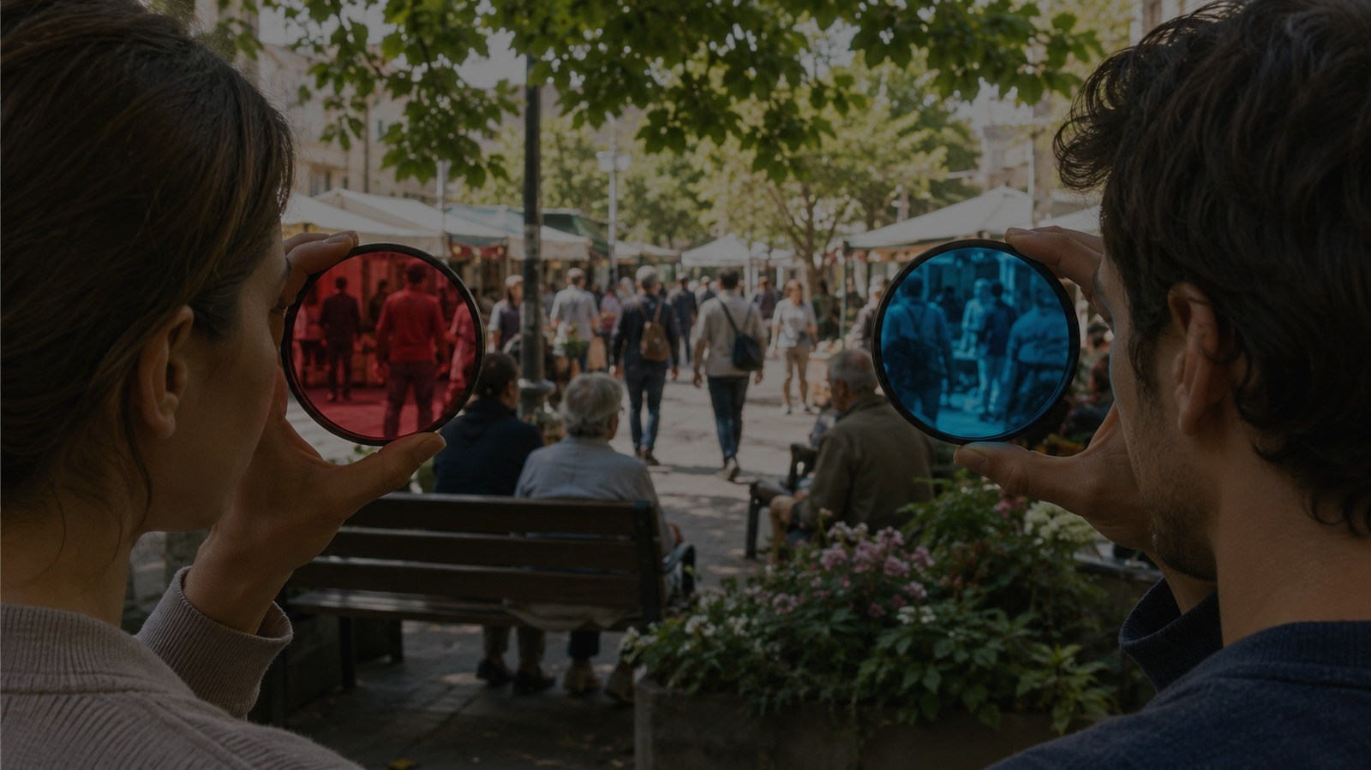
Key concepts to teach through Miner
Ethnocentrism
Judging another culture through your own standards.
Cultural relativism
Understanding behaviour within its social context.
Social construction
Meanings are created by people, institutions and culture.
Norms + values
Repeated behaviours show what a group expects and values.
Notes:
Use the lens image to frame the lesson: the same behaviour can be seen differently depending on the observer’s cultural position.

Slide 5
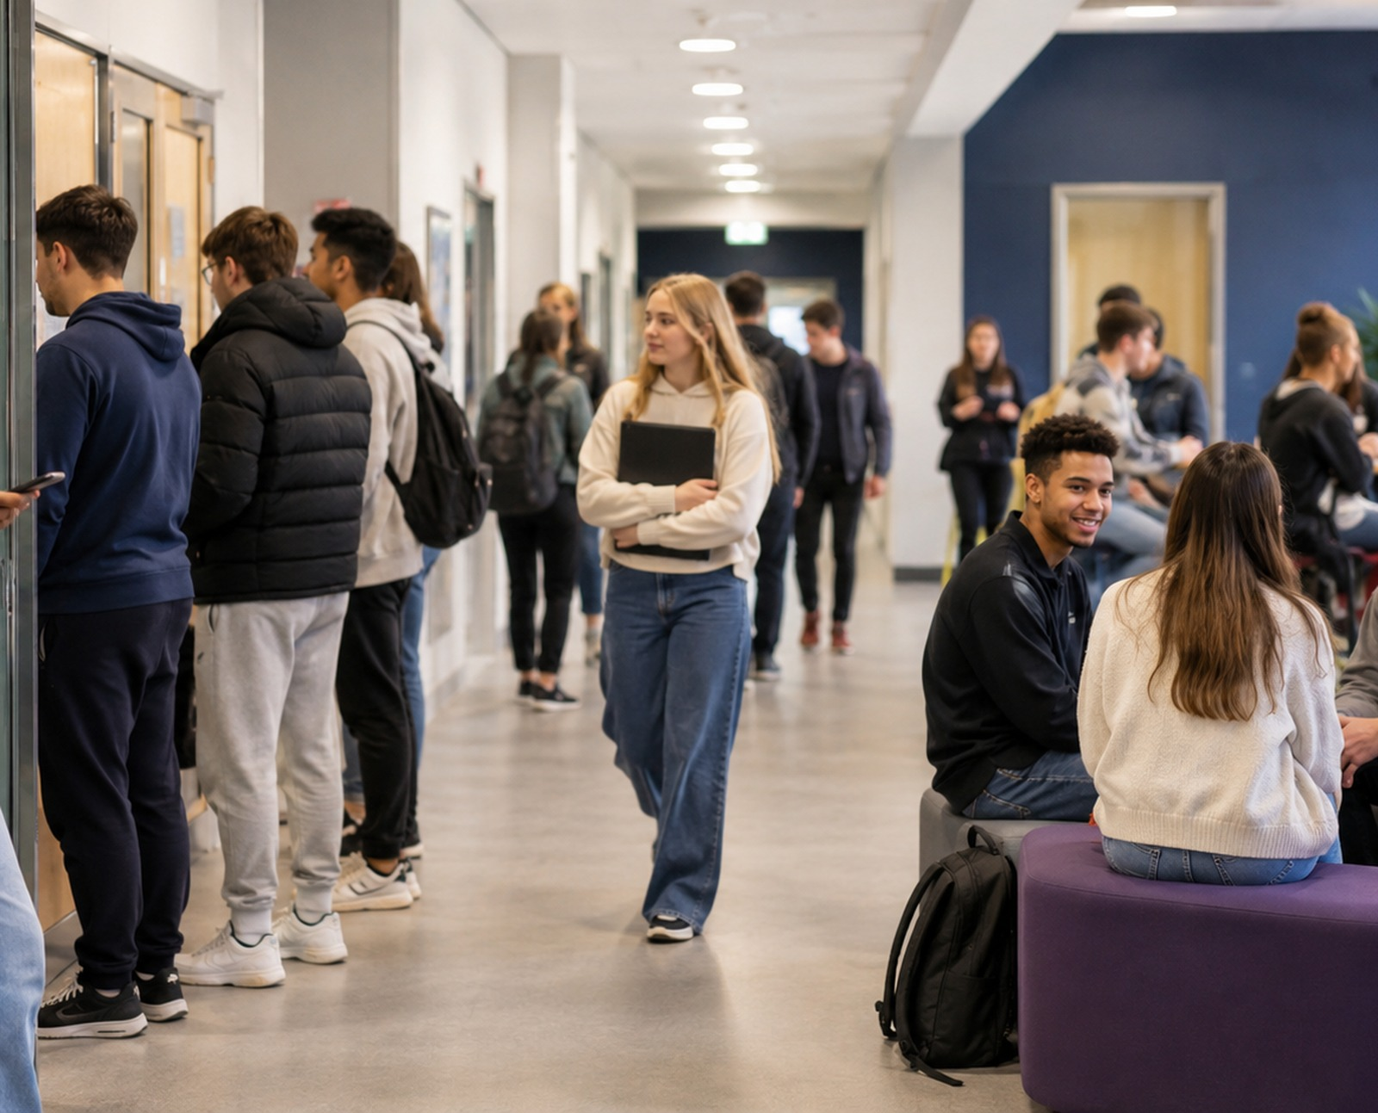
Activity: Strange Rituals
Students describe familiar school or college routines as an outsider.
Learning outcomes
By the end, students should be able to:
1 Explain how culture shapes everyday behaviour
2 Identify norms, values and agents of socialisation
3 Apply cultural relativism to familiar UK examples
4 Avoid ethnocentric “that’s weird” explanations
Time
45–60 minutes
Group size
Pairs or 3s
Output
Mini field report
The Sociology Guy | OCR + AQA A-level Sociology
05
Notes:
The activity uses familiar UK student life: phones, queues, uniforms, timetables, revision, classroom rules and school/college rituals. It is deliberately low-stakes and accessible.

Slide 6
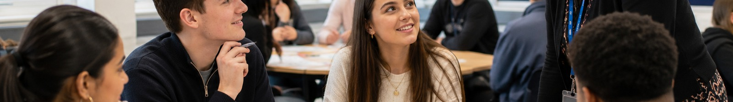
Lesson flow: teacher instructions
A four-stage structure that moves from curiosity to exam-ready concepts.
1
2
3
4
Reveal
Decode
Create
Apply
Read a short Nacirema extract or summary. Ask students: what does this society seem to value?
Reveal the anagram. Link to “making the familiar strange” and cultural relativism.
Pairs write an outsider description of a UK student ritual without naming it.
Students decode norms, values, socialisation and possible sanctions.
Teacher cue: keep the tone analytical, not mocking. The target is familiar routines and hidden social rules.
The Sociology Guy | OCR + AQA A-level Sociology
06
Notes:
The reveal works best if students have a moment to take Miner literally first. After the reveal, stress that sociologists often analyse everyday life rather than treating it as obvious or natural.

Slide 7

Student task sheet
Choose one “ritual”, write it like an outsider, then decode the sociology.
Choose one everyday UK student routine:
Checking a phone before lesson
Queueing in the canteen
Wearing uniform / lanyards
Revision before exams
Saying “sorry” automatically
Group chat behaviour
A classroom seating pattern
Prom / leavers’ rituals
Gym / body routines
Write it without naming it:
“Before entering the learning chamber, young members consult a small glowing object. Some seem anxious if the object is silent or missing.”
Then decode: norms • values • socialisation • sanctions • cultural relativism
The Sociology Guy | OCR + AQA A-level Sociology
07
Notes:
You can print this slide as a one-page task prompt. Students do not need to write perfectly; the aim is to notice how language changes the meaning of ordinary behaviour.

Slide 8
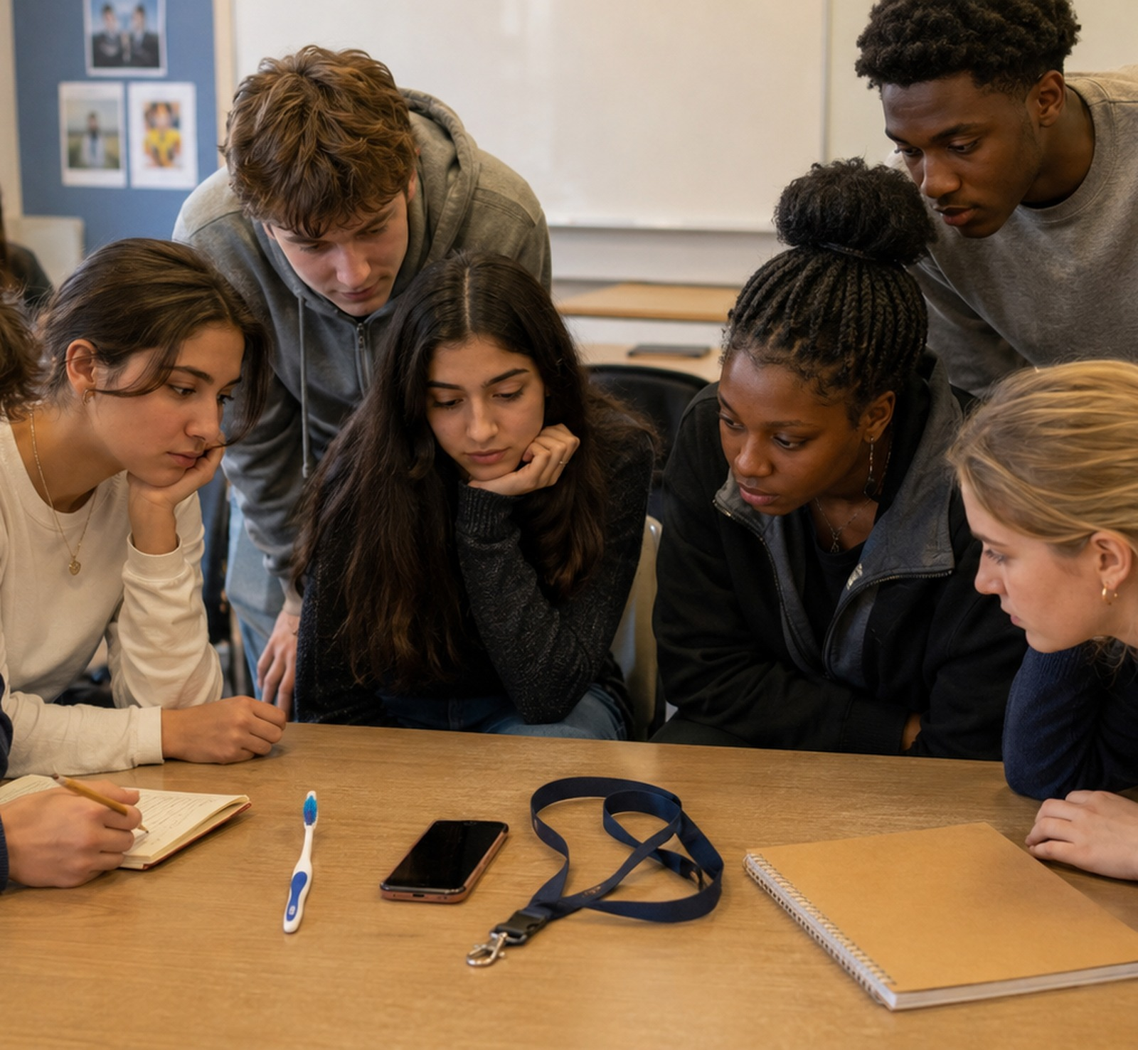
Teacher guidance
Push students from description towards explanation.
Prompts to circulate with
Norms
What unwritten rule is being followed?
Values
What does this behaviour show the group thinks is important?
Socialisation
Who teaches this behaviour — family, school, peers, media?
Sanctions
What happens if someone refuses to join in?
Relativism
Why might an outsider misunderstand this behaviour?
Differentiation
Support: give a ritual and sentence starter. Challenge: add a theory link such as functionalism, interactionism or feminism.
The Sociology Guy | OCR + AQA A-level Sociology
08
Notes:
Listen for students who only say “it is weird”. Redirect them to sociological vocabulary: norms, values, socialisation, sanctions and cultural relativism.

Slide 9
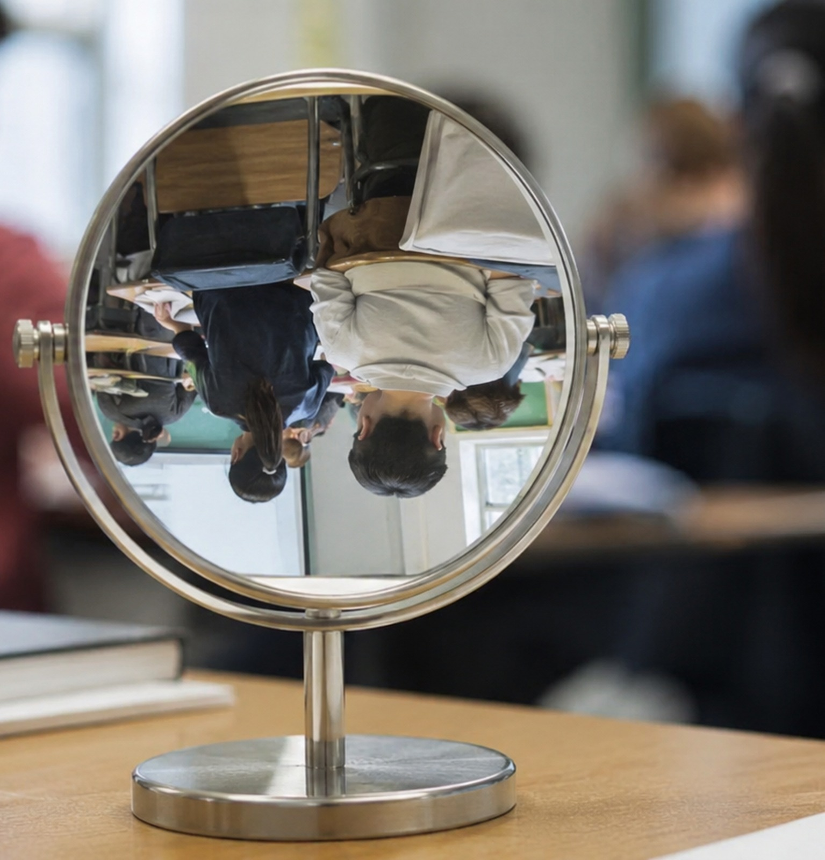
Model answer and exam links
A short model paragraph students can imitate for OCR or AQA questions.
Model application
A classroom seating pattern can be seen as a cultural ritual because students learn where to sit, when to speak and how to show respect for the teacher. These behaviours are not natural; they are taught through school socialisation and supported by sanctions such as praise, warnings or peer judgement. Miner’s study helps us see that familiar routines can look strange when described from the outside, which is useful for understanding the relative nature of culture.
OCR-style link
Explain how Miner’s study can help sociologists understand the relative nature of culture.
AQA-style link
Outline and explain two ways everyday routines may be shaped by culture.
The Sociology Guy | OCR + AQA A-level Sociology
09
Notes:
Use this slide to show students how to move from the activity to an exam paragraph. They should define the concept, apply it to an example and make a clear point about culture being learned/socially constructed.

Slide 10
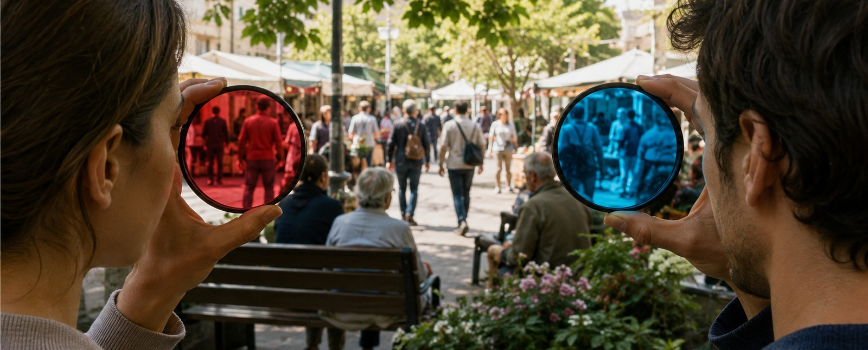
References and teaching notes
Core study
Classroom safeguard
Miner, H. (1956). “Body Ritual among the Nacirema.” American Anthropologist, 58(3), 503–507. DOI: 10.1525/aa.1956.58.3.02a00080.
Also available through AnthroSource/Wiley and JSTOR. Use short extracts only, then paraphrase and decode with students.
Use the activity to analyse familiar UK routines, not to ridicule minority cultures. The best answers explain how meanings are learned, shared and enforced through social life.
Specification links
OCR H580: Socialisation, Culture and Identity; relative nature of culture, norms, values, socialisation and identity.
AQA 7192: Core themes of socialisation, culture and identity; useful for Culture and Identity, Education, and introductory sociological thinking.
Images: AI-generated, text-free classroom and sociology visuals for use in this teaching deck.
Notes:
End by returning to the key phrase: sociology makes the familiar strange. This can become a recurring classroom phrase throughout the course.

