Slide 1


Age inequalities and ageism
Age as a dimension of social inequality • Age and employment
Cambridge OCR A Level Sociology
Component 2 Section B: Understanding Social Inequalities
Youth • Old age • Dependency • Work • Retirement
Notes:
Introduce age as a social inequality. Stress that age is biological but also socially organised through rights, expectations, stereotypes and institutional treatment. The lesson covers both young people and older people, then applies this to work and employment.

Slide 2
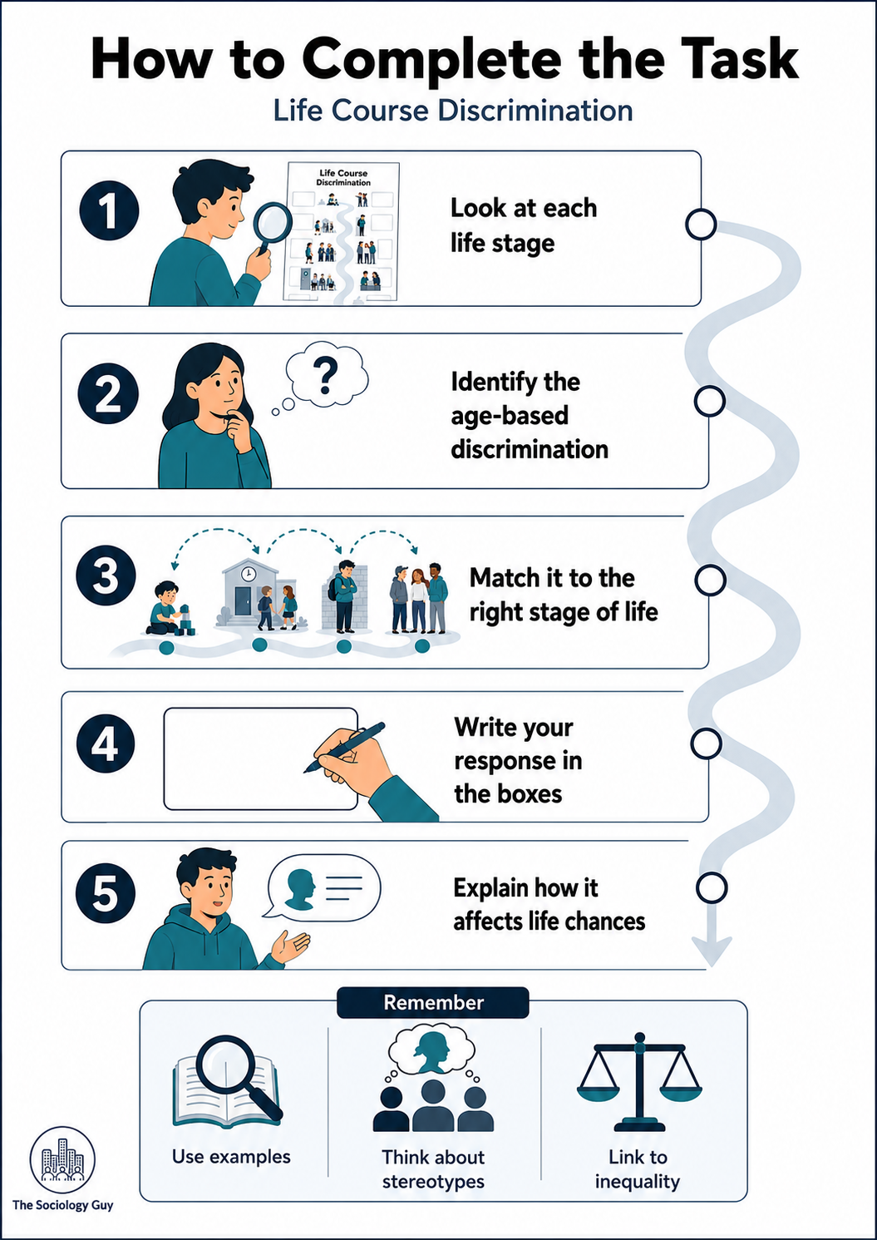
What students should be able to explain
Translate Q1 into clear knowledge, application and evaluation.
Define age inequality, ageism, youth, old age, dependency and intergenerational inequality.
AO1
Apply examples to young people, older people and workplace experiences.
AO2
Evaluate whether age alone explains inequality or whether class, gender, disability and ethnicity also matter.
AO3
Big question: Is age inequality mainly about old age, or does it operate across the whole life course?
Cambridge OCR A Level Sociology • Component 2 Section B • Age inequalities • 2
Notes:
Use this slide to set up the lesson. Students often assume ageism means discrimination against older people only. The OCR topic requires students to consider both young people and old age.

Slide 3
Key terms for Q1
Students need precise language before they evaluate evidence.
Age
Ageism
Youth
A social category linked to rights, roles and expectations.
Stereotyping, prejudice or discrimination based on age.
A life stage often associated with transition, risk and control.
Old age
Dependency
Intergenerational inequality
A later life stage often linked to dependency, retirement and invisibility.
A socially constructed idea that some groups need support or control.
Unequal resources or opportunities between age cohorts.
Starter: choose one term and write a one-sentence example from everyday life.
Cambridge OCR A Level Sociology • Component 2 Section B • Age inequalities • 3
Notes:
Students can use the terms to build exam paragraphs. Encourage them to separate prejudice, stereotypes, discrimination and structural inequality.

Slide 4
Age is organised across the life course
Hockey and James (1993): society creates stages and expectations.
Core idea
The life course is divided into stages: childhood, youth, adulthood and old age.
Each stage carries social expectations about independence, dependency, responsibility and competence.
Inequality can arise when these expectations limit what people are allowed to do.
Exam application: link age to life chances by showing how social rules shape education, work, health, family and public space.
Source: Hockey and James, Growing Up and Growing Old: Ageing and Dependency in the Life Course, 1993.
Cambridge OCR A Level Sociology • Component 2 Section B • Age inequalities • 4
Notes:
Hockey and James argue that dependency is socially organised across the life course. Children and older people can both be treated as dependent, although the form of dependency differs. Use this to challenge the idea that age is just biological.

Slide 5

Ageism: more than individual prejudice
Ageism can be cultural, institutional and everyday.
Three levels
Cultural
Media and everyday talk construct youth as risky or old age as decline.
Institutional
Rules, services and workplaces may organise people by chronological age.
Everyday
Small assumptions: “too young”, “too old”, “not worth training”.
Quick task: Which example is direct discrimination, and which is stereotyping?
Sources: Ray, Sharp and Abrams (2006); Bytheway (2005/2007) on ageism and age categorisation.
Cambridge OCR A Level Sociology • Component 2 Section B • Age inequalities • 5
Notes:
Ray, Sharp and Abrams produced a benchmark report on public attitudes to age discrimination. Bytheway’s work is useful for showing how chronological age categories can structure everyday treatment and institutional decisions.

Slide 6
Inequalities affecting young people
Youth can be associated with control, suspicion and weak power.
Young people may be stereotyped as risky, irresponsible or immature.
They can face suspicion in public spaces, policing, shops and schools.
Lower pay rates and insecure entry-level work can reduce independence.
Political voice can be weaker because many young people lack voting power or influence.
OCR link: youth marginalisation becomes inequality when stereotypes restrict education, work, housing, public space or political influence.
Cambridge OCR A Level Sociology • Component 2 Section B • Age inequalities • 6
Notes:
This slide focuses on youth. Students can connect ageism to ideas of youth marginalisation, public-space control and dependency. Encourage examples from shops, schools, policing, employment and housing.

Slide 7
Inequalities affecting older people
Old age can be constructed through decline, dependency and burden.
Older people may be stereotyped as dependent, frail, resistant to change or less productive.
Health concerns may be dismissed as “just ageing”.
Digital services can exclude people who lack access, confidence or support.
Milne (1999) helps balance this by showing old age is not only dependency: older people may also have consumer and political power.
Evaluation: Does the idea of “grey power” challenge the stereotype of older people as powerless?
Cambridge OCR A Level Sociology • Component 2 Section B • Age inequalities • 7
Notes:
OCR lists Milne (1999) for age inequalities. Use Milne to introduce the idea that older people are not all disadvantaged in the same way. Some may have political, consumer or housing wealth advantages, whereas others experience poverty, isolation or poor health.

Slide 8
Intergenerational inequality
Age groups can have unequal access to resources and security.
Possible areas of debate
housing wealth
tuition fees and debt
pensions and retirement
care responsibilities
tax and welfare
family support
Student judgement: Is intergenerational inequality really about age, or about class and wealth within each generation?
Cambridge OCR A Level Sociology • Component 2 Section B • Age inequalities • 8
Notes:
This slide introduces intergenerational inequality. The key evaluation is that age cohorts are not internally equal. Wealthier young people may receive family support, while poorer older people may face poverty and ill-health.

Slide 9

Age and work/employment
Age can shape entry, security, training, promotion and exit.
Young workers: lack of experience, lower pay, unstable contracts and NEET risk.
Mid-life workers: career/family expectations and responsibility pressures.
Older workers: exclusion from training, assumptions about adaptability and pressure to retire.
Workplaces may use age as a shortcut for judging competence or future value.
Key concept: age discrimination in employment
Cambridge OCR A Level Sociology • Component 2 Section B • Age inequalities • 9
Notes:
This introduces the second specification section: age and work. Students should explain employment chances, training opportunities, unemployment, retirement and workplace treatment.

Slide 10
Young people and employment chances
NEET evidence shows how early labour-market exclusion can affect life chances.
13.5%
of people aged 16–24 were NEET in Jan–Mar 2026.
1.01m
young people were not in education, employment or training.
+89k
increase compared with the previous year.
Sociological link
Youth unemployment can have “scarring effects”: reduced confidence, weaker CVs, lower future earnings and delayed independence.
Source: House of Commons Library, NEET: Young People Not in Education, Employment or Training, 5 June 2026, using ONS data.
Cambridge OCR A Level Sociology • Component 2 Section B • Age inequalities • 10
Notes:
Use this slide to show a contemporary evidence point. The House of Commons Library briefing summarises ONS data, reporting that 1.01 million people aged 16 to 24 were NEET in Jan-Mar 2026, or 13.5% of the age group, up by 89,000 on the year.

Slide 11
Older workers: employment, inactivity and retirement
Not all exit from work is voluntary or equal.
26.1%
economic inactivity rate for people aged 50–64 in 2025.
30.0%
economic inactivity rate for women aged 50–64.
572k
inactive 50–64-year-olds wanted or would like to work.
Evaluation
Older age interacts with health, caring, gender, qualifications and region. Avoid treating “older workers” as one group.
Source: DWP/GOV.UK, Economic labour market status of individuals aged 50 and over, September 2025.
Cambridge OCR A Level Sociology • Component 2 Section B • Age inequalities • 11
Notes:
The GOV.UK release reports a 26.1% inactivity rate for people aged 50 to 64 in 2025, higher for women at 30.0%. It also reports around 572,000 inactive people aged 50 to 64 who would like to work. Use this to challenge the assumption that older workers always choose retirement freely.

Slide 12
Training and workplace treatment
Ageism can operate through subtle decisions, not just explicit rejection.
Recruitment
older applicants seen as “less flexible”; young applicants seen as “unproven”.
Training
older workers excluded because managers assume less future return.
Promotion
young workers seen as immature; older workers seen as near retirement.
Exit
retirement framed as natural even when people want or need to continue working.
Apply: Is this discrimination direct, indirect, stereotyping or structural inequality?
Sources: Ray, Sharp and Abrams (2006); Bytheway et al. (2007) on everyday ageism and discrimination.
Cambridge OCR A Level Sociology • Component 2 Section B • Age inequalities • 12
Notes:
Use workplace scenario cards here if available. The key sociological move is to show age discrimination can occur through informal assumptions and organisational routines.

Slide 13

Classroom task: life course discrimination timeline
Move from examples to explanation and evaluation.
Student instructions
1
Place each discrimination example on the life course timeline.
2
Identify the stereotype or assumption behind it.
3
Explain how it may affect life chances.
4
Decide whether young people or older people face the more damaging inequality.
Judgement question: At which stage of the life course is age discrimination most damaging to life chances?
Cambridge OCR A Level Sociology • Component 2 Section B • Age inequalities • 13
Notes:
This slide links directly to the printable resource pack. Students should not just place examples; they should explain mechanism and evaluate impact.

Slide 14
Build an OCR-style paragraph
Point • Evidence • Concept • Consequence • Evaluation
Example structure
Age inequality can affect employment because…
This is shown by…
This links to ageism because…
The impact on life chances may be…
However, this may depend on…
Challenge: use one named study and one contemporary statistic.
Plenary: “Age inequality is experienced more severely in old age than youth.” Agree or disagree?
Cambridge OCR A Level Sociology • Component 2 Section B • Age inequalities • 14
Notes:
This is an exam skills slide. Encourage students to include a named study, concept and evidence. For evaluation, they might argue that age interacts with class, gender, disability, ethnicity and region.

Slide 15
Sources and further reading
Use these to support teacher explanation and student evidence.
Hockey, J. and James, A. (1993) Growing Up and Growing Old: Ageing and Dependency in the Life Course.
Milne (1999) — OCR suggested study used to discuss older people, “grey power” and the changing meaning of old age.
Ray, S., Sharp, E. and Abrams, D. (2006) Age Discrimination: A Benchmark of Public Attitudes. Age Concern England.
Bytheway, B. (2005/2007) work on ageism, age categories and everyday ageism.
ONS / House of Commons Library (2026) NEET: Young People Not in Education, Employment or Training.
DWP / GOV.UK (2025) Economic labour market status of individuals aged 50 and over.
ONS Labour Market by Age tables: employment, unemployment and economic inactivity by age group.
Teaching note: update ONS labour-market figures each year so students practise using current evidence.
Cambridge OCR A Level Sociology • Component 2 Section B • Age inequalities • 15
Notes:
This slide lists sources used in the presentation. Students do not need full bibliographic detail in exam responses, but they should be able to use named studies and accurate contemporary evidence.

