Slide 1
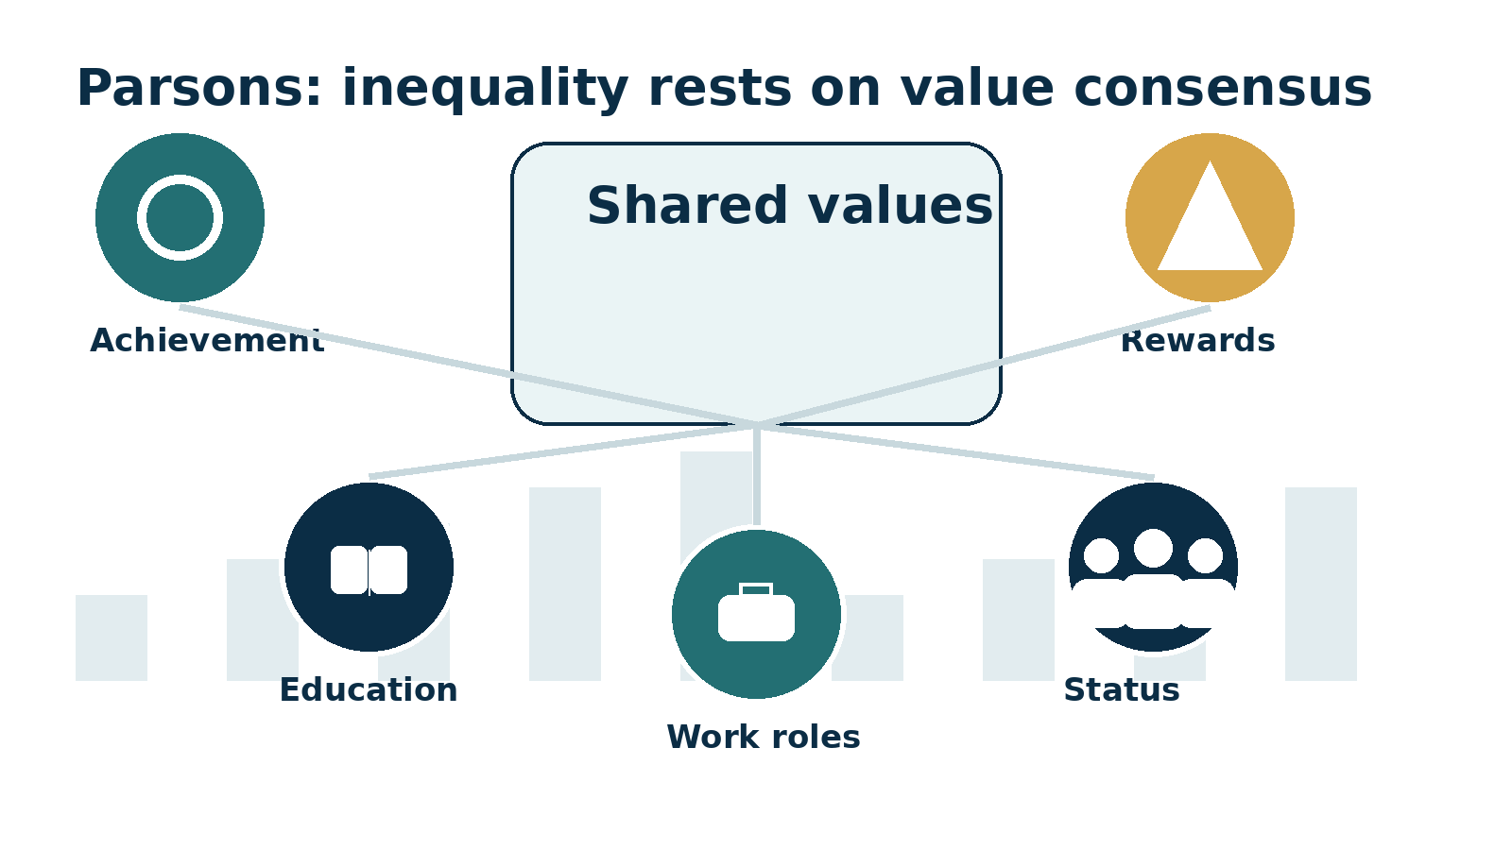

Parsons (1977)
Cambridge OCR • Component 2
Teacher deck
Meritocracy, values and social inequality

Slide 2

Lesson focus
Specification point: functionalist views on social inequality
Students should be able to
Key concepts
Assessment focus
Explain Parsons’ view that inequality is linked to shared values, role allocation and meritocratic rewards.
Value consensus • achievement • meritocracy • role allocation • status • stratification • social order.
AO1: explain concepts • AO2: apply to class, education and work • AO3: evaluate using evidence.
Cambridge OCR A Level Sociology • Parsons (1977) • Social Inequality • 2

Slide 3
Starter: the values auction
Interactive activity 1 • five minutes
Each pair has 10 imaginary tokens. “Buy” the values you think society rewards most.
Exam success
Hard work
Wealth
Care for others
Creativity
Risk taking
Obedience
Leadership
Share
Explain
Link
Which value attracted the most tokens?
Who benefits when this value is rewarded?
Parsons argues ranking rests on shared values.
Cambridge OCR A Level Sociology • Parsons (1977) • Social Inequality • 3

Slide 4
Who was Parsons?
Structural functionalism and the problem of social order
Talcott Parsons saw society as a system of connected institutions.
Institutions such as family, education and work help maintain order.
By 1977, Parsons had revisited social stratification and linked inequality to values, power and solidarity.
For OCR, his importance is the claim that inequality can be legitimate when people believe rewards are earned.
Source focus: Parsons (1977), functionalist stratification; use with Cambridge OCR social inequalities specification.
Cambridge OCR A Level Sociology • Parsons (1977) • Social Inequality • 4

Slide 5
Parsons’ main idea
Inequality is organised around value consensus
Value consensus
Members of society broadly agree that some qualities and achievements are more valuable than others.
Ranking
People and roles are ranked according to how well they fit these shared values.
Legitimacy
Inequality is accepted more easily when rewards appear to reflect achievement.
Social order
Shared values help explain why unequal rewards do not always produce conflict.
Cambridge OCR A Level Sociology • Parsons (1977) • Social Inequality • 5

Slide 6
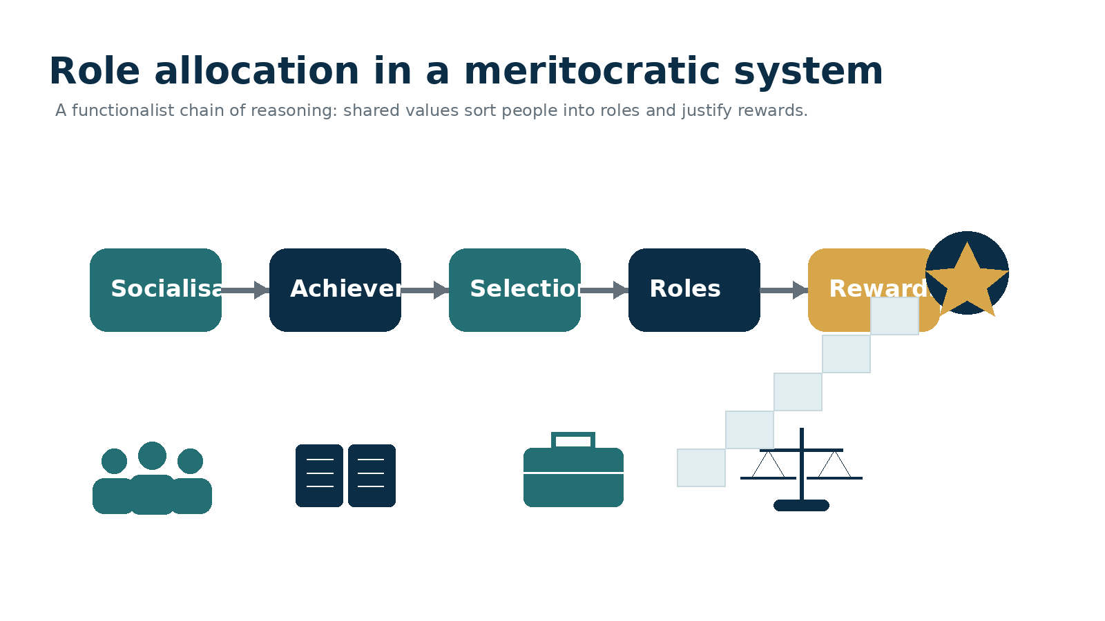
The Parsons chain
How inequality can appear fair in a meritocratic society
Cambridge OCR A Level Sociology • Parsons (1977) • Social Inequality • 6

Slide 7
Meritocracy and role allocation
How education and work sort people into positions
Meritocracy
Education
Work
A system where rewards are supposed to be based on talent, effort and achievement.
Schools transmit achievement values and sort students through qualifications.
Employers allocate people to roles using credentials, experience and performance.
Parsons would see this as a bridge from family background to adult status.
The problem: students must test whether this bridge is genuinely fair.
AO2
Apply this to class inequality, education, income and social mobility.
AO3
Evaluate whether the competition starts from equal positions.
Cambridge OCR A Level Sociology • Parsons (1977) • Social Inequality • 7

Slide 8
Evidence that partly supports Parsons
Qualifications are linked to occupational rewards
41%
Higher degree holders aged 25-29 earned more than those with no GCSEs, controlling for socio-economic background.
27%
Undergraduate degree holders aged 25-29 earned more than comparable young people with no GCSEs.
Parsons link
Role allocation
Evaluation
Qualifications can act as recognised evidence of achievement.
Education may help sort people into work roles requiring different levels of skill.
This does not prove opportunities are equal; it only shows qualifications matter.
Evidence: Social Mobility Commission, income returns to education, data for 3 years to 2024.
Cambridge OCR A Level Sociology • Parsons (1977) • Social Inequality • 8

Slide 9
Activity 2: role allocation grid
Limited resources: board, scrap paper or exercise books
Place each occupation on two axes: “socially valued” and “highly rewarded”. Then discuss mismatches.
HIGH SOCIAL VALUE
CEO
Nurse
Cleaner
Teacher
Carer
Parsons question
Are high rewards attached to society’s most valued roles?
Engineer
MP
Delivery rider
Doctor
Influencer
Critical question
Which important roles are undervalued?
LOW REWARD
HIGH REWARD
Cambridge OCR A Level Sociology • Parsons (1977) • Social Inequality • 9

Slide 10
Parsons in 1977
Equality and inequality in modern society
Parsons did not simply say “all inequality is good”.
He argued that modern societies combine equality of citizenship with unequal achievement-based rewards.
Inequality becomes more legitimate when linked to universalistic standards, such as qualifications and performance.
This helps explain why people may accept unequal income if they believe the system is fair.
Key phrase
Exam move
“Inequality is accepted when it appears to reflect shared values and achievement.”
Always evaluate whether the system really measures achievement fairly.
Cambridge OCR A Level Sociology • Parsons (1977) • Social Inequality • 10

Slide 11
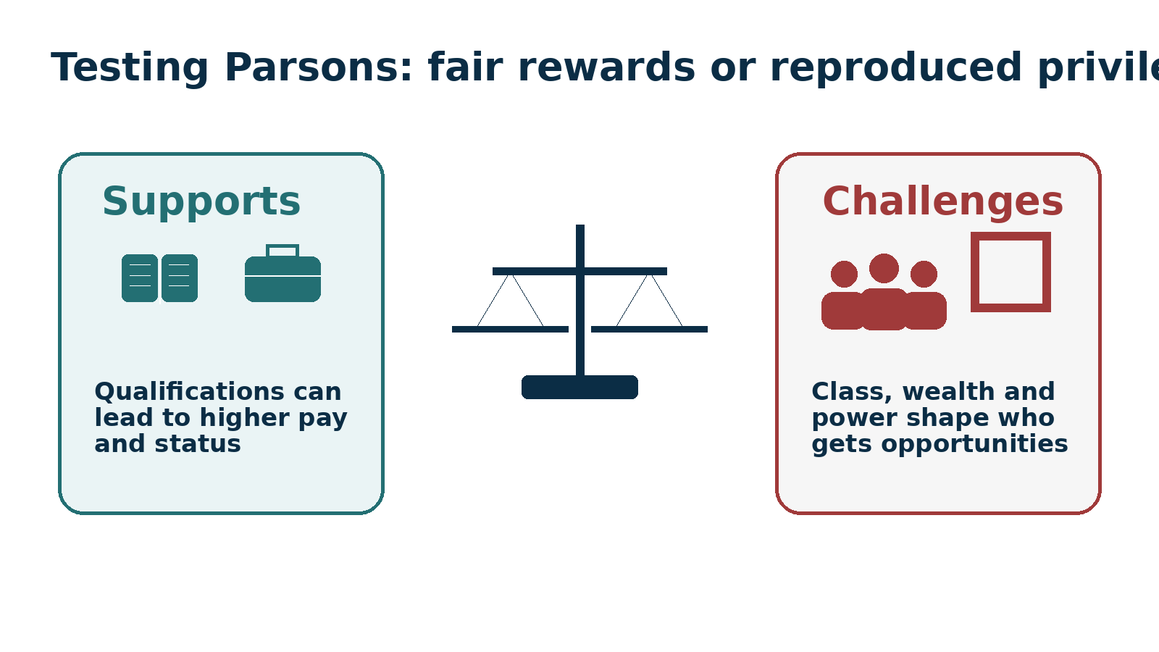
Criticism: unequal starting points
Meritocracy is weaker when wealth and opportunity are inherited
10%
The wealthiest 1% of households held the same share of wealth as the least wealthy 50% combined.
£1.2m
The wealthiest 10% of households had wealth of £1,200,500 or more.
£16.5k
The least wealthy 10% had £16,500 or less.
Evaluation
If families pass on wealth and advantage, rewards may reproduce privilege rather than merit.
Evidence: ONS household wealth, Great Britain, April 2020 to March 2022; House of Commons Library summary.
Cambridge OCR A Level Sociology • Parsons (1977) • Social Inequality • 11

Slide 12
Criticism: whose values count?
Marxist, feminist and Weberian responses
Marxist critique
Feminist critique
Weberian critique
Shared values may be ruling-class ideology. Inequality can protect ownership and class power.
Care work and domestic labour are essential but often undervalued and underpaid.
Rewards may reflect market situation, status closure and power rather than functional importance.
Class discussion: is society rewarding contribution, scarcity, power or cultural status?
Contribution
Scarcity
Power
Credentials
Networks
Inheritance
Cambridge OCR A Level Sociology • Parsons (1977) • Social Inequality • 12

Slide 13
Activity 3: Parsons evaluation corners
Limited resources: four corners of the classroom
Statement 1
Statement 2
“Inequality motivates people to work harder.”
“Education is broadly meritocratic.”
Statement 3
Statement 4
“High pay usually reflects social importance.”
“Inequality creates social order more than conflict.”
Corners
Rules
Upgrade
Strongly agree • agree • disagree • strongly disagree.
Move to a corner. Use Parsons and evidence to justify your position.
Change corner if another student gives stronger evidence.
Cambridge OCR A Level Sociology • Parsons (1977) • Social Inequality • 13

Slide 14
OCR paragraph scaffold
Explain and evaluate Parsons on social inequality
Point
Parsons argues that social inequality is linked to value consensus and meritocratic role allocation.
Explain
Society ranks people and roles according to shared values such as achievement, responsibility and contribution.
Apply
In education and work, qualifications may operate as evidence of achievement, linking effort to rewards.
Evidence
Data on income returns to education supports the idea that qualifications bring labour market rewards.
Evaluate
However, wealth inequality and unequal access to opportunities suggest that rewards are not purely meritocratic.
Judgement
Parsons explains why inequality may appear legitimate, but critics argue it can reproduce privilege.
Cambridge OCR A Level Sociology • Parsons (1977) • Social Inequality • 14

Slide 15
Plenary: one sentence judgement
What should students remember?
Complete one of these sentences:
Sentence 1
Parsons is useful because...
Sentence 2
Parsons is limited because...
Sentence 3
The strongest evidence against meritocracy is...
Best answer uses: concept + evidence + judgement.
Cambridge OCR A Level Sociology • Parsons (1977) • Social Inequality • 15

Slide 16
Teacher reference slide
Sources and evidence used in this deck
Parsons, T. (1977) writings on equality, inequality and social stratification.
Social Mobility Commission: income returns to education, data for the 3 years to 2024.
ONS: household total wealth in Great Britain, April 2020 to March 2022.
House of Commons Library: Wealth in Great Britain briefing.
Cambridge OCR A Level Sociology: Component 2, Understanding Social Inequalities.
Teacher note
The aim is not to prove Parsons right or wrong, but to help students explain, apply and evaluate the functionalist position.
Cambridge OCR A Level Sociology • Parsons (1977) • Social Inequality • 16

